Slide 1
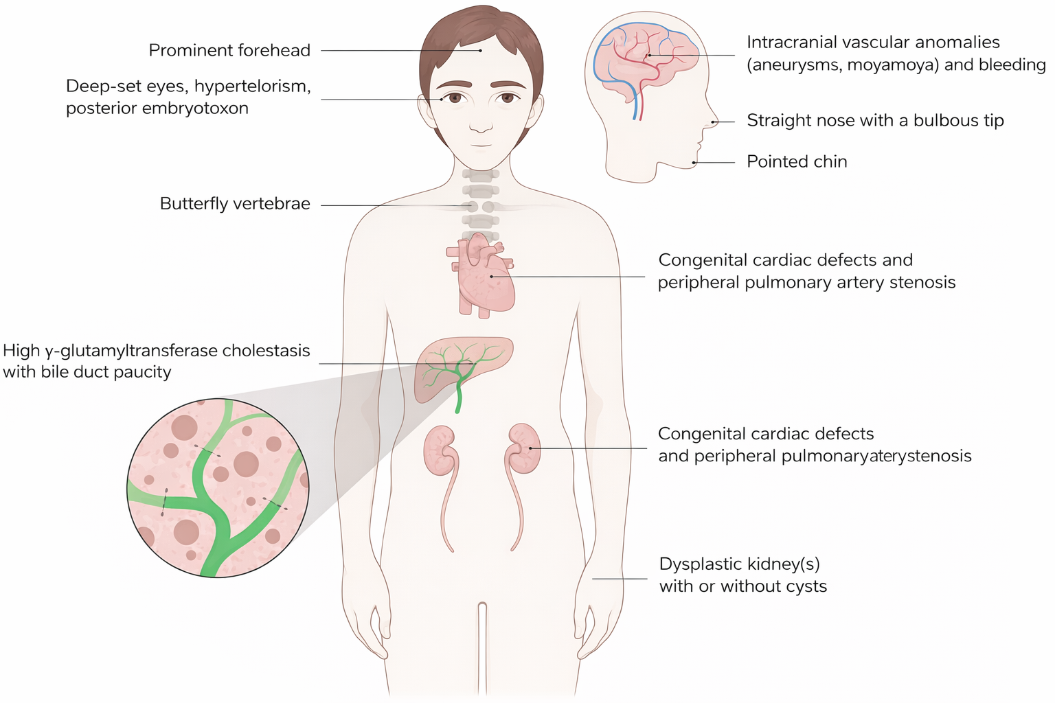
Alagille Syndrome
Jihyun Bang, Maya Clapperton, Abrar Faruque, Rohan Sampy, Brenda Soljic

